Slide 1
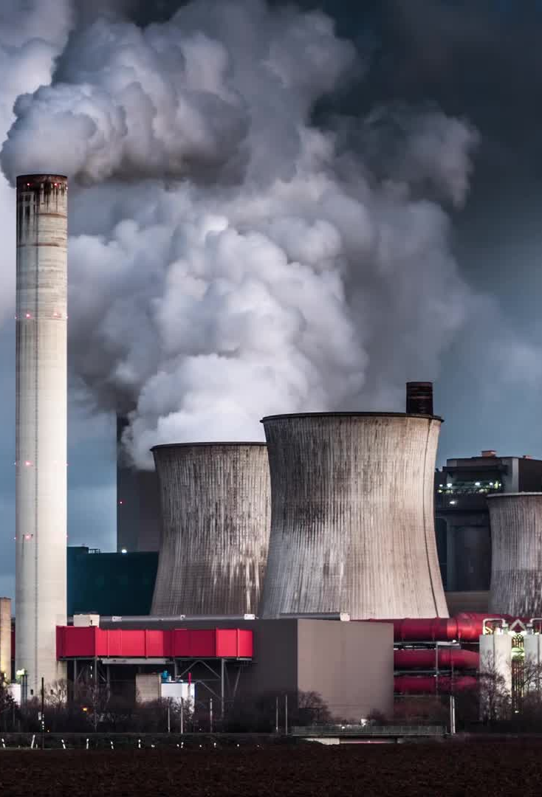

Modelling pollution in the urban environment using neural networks
Hanson Shen
Prof Christopher C. Pain
Dr Claire E. Heaney
Dr Boyang Chen
1
Notes:
Good morning, everyone, my name is Hanson Shen.
Today I’ll be presenting our work on modelling pollution in urban environment using neural networks.
This research was conducted under the guidance of Prof Christopher Pain, Dr. Claire Heaney, and Dr. Boyang Chen

Slide 2

CONTENTS
1
4
Introduction
Results
2
5
Literature Review
Conclusion
3
Methodology
2
Notes:
Before diving into the details, I’d like to give a brief overview of today’s presentation.
We’ll begin by discussing the growing concerns surrounding air pollution
Then we’ll explore the limitations of traditional modelling methods and introduce our proposed approach that offers a more accurate solution.
And then we'll go through the methodology, present our results, and finally, discuss the conclusions we’ve drawn from this study.

Slide 3
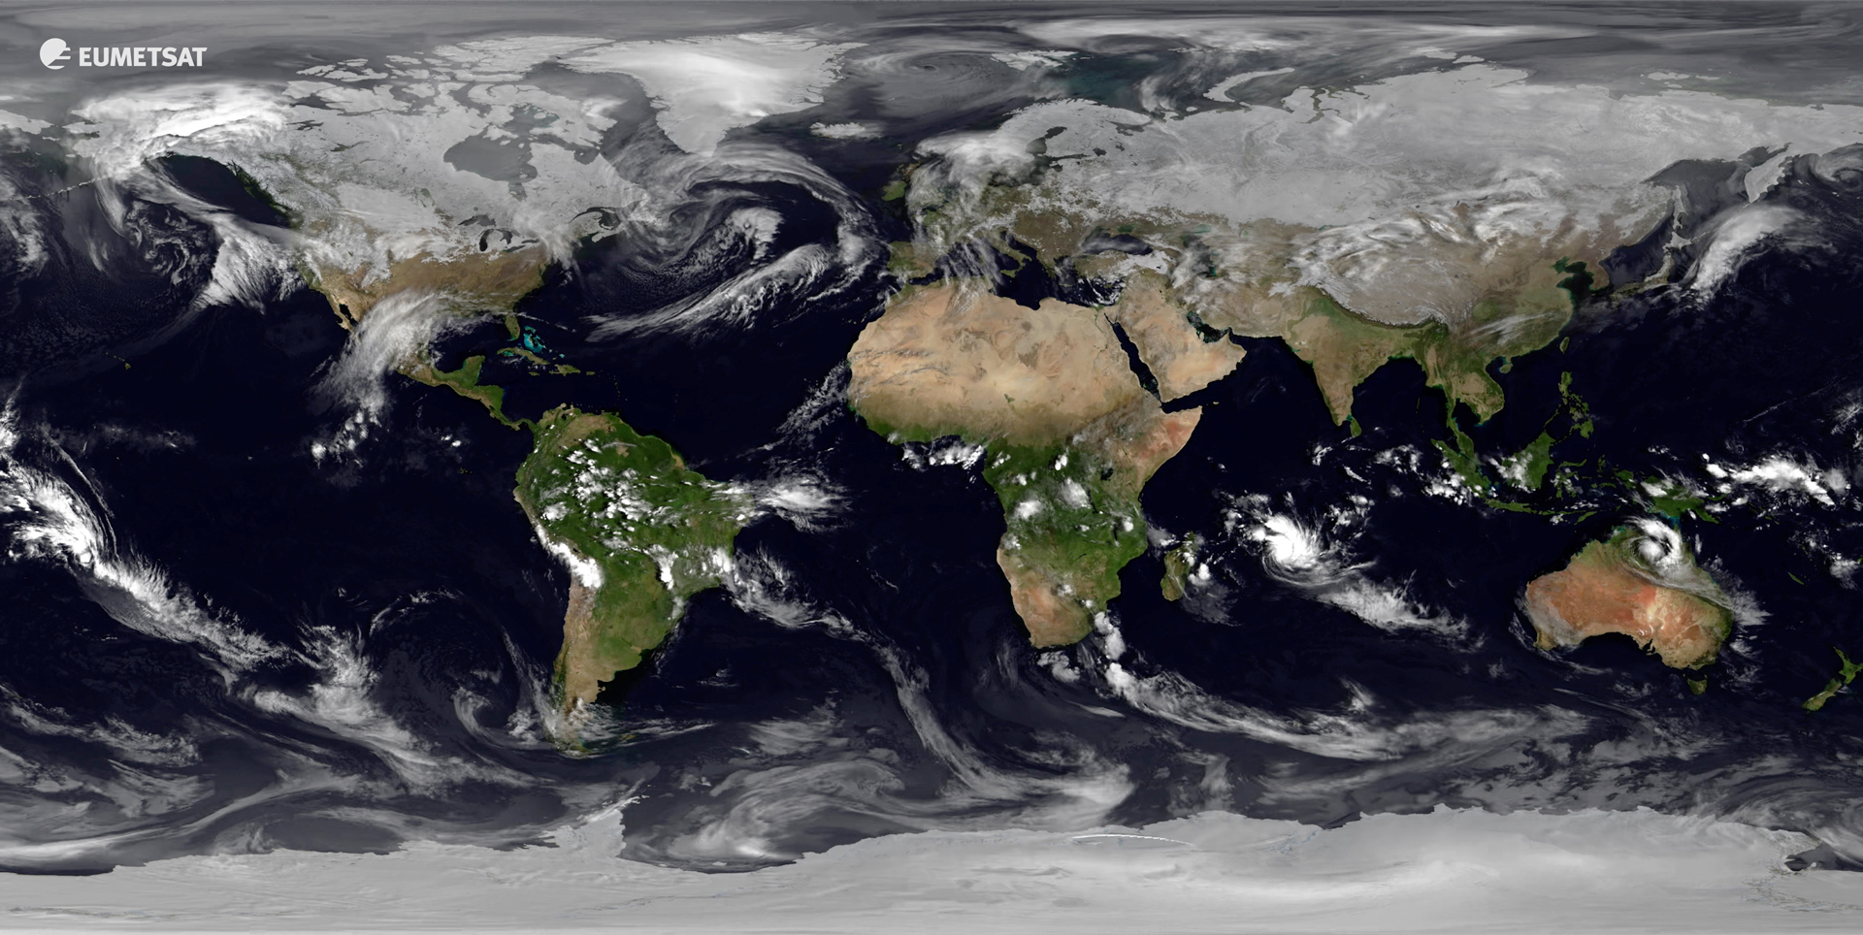
INTRODUCTIOIN
Topic
Air Pollution
Public Health Concern
Question
Prediction Accuracy
Limitations of Traditional Methods
Answer
Comprehensive Framework incorporating
- Neural Networks
- Computational Fluid Dynamic
- Data Assimilation
3
Notes:
To begin with, air pollution is a pressing issue, and its negative effects on human health are well-documented.
And traditional methods of predicting pollution, while useful, often struggle with accuracy and adaptability to changing environments or real world condition.
Thus, our research addresses these limitations by proposing a comprehensive framework
that combines the predictive power of NN and CFD, with the improvement in accuracy using DA

Slide 4

LITERATURE REVIEW
1
2
3
Neural Networks
&
Computational Fluid Dynamics
Traditional Modelling
v.s.
Convolutional VAE
Assimilation
with
Observational Data
NN-based Solver for PDEs
Potential and Performance
Generation of Predictions
Computational Resources
Reducing Dimensionality
Refining the Model
Adjusting to Realistic Environment
Accuracy of Predictions
Using ai libraries for incompressible
computational fluid dynamics (Chen et al.)
Bridging observations, theory and numerical simulation
of the ocean using machine learning (Sonnewald et al.)
Data assimilation in the latent space
of a neural network (Amendola et al.)
4
Notes:
To better understand our approach, it’s important to look at the existing literature on pollution modelling.
Firstly, recent research has shown that NNs demonstrate high performance on solving PDE, which is the essential mechanism of pollution dispersion
Besides that, the utilisation of AE can greatly reduce limitations that traditional modelling methods have, such as the lack of efficiency.
And finally, DA includes repetitive correction of the model with observational data, which provides a more accurate prediction
---extra---
Besides that, traditional models rely on statistical methods and simplified physical equations.
However, they all have limitations such as insufficient accuracy and high computational cost.
As a result, the utilisation of AE can greatly reduce the complexity of the data, and this also leads to the third point, DA
However, without the compression of the data using AE, we wouldn’t be able to increase the efficiency of the model.
So, in other words, the AE and DA process benefit each other in terms of efficiency and performance in our approach.

Slide 5
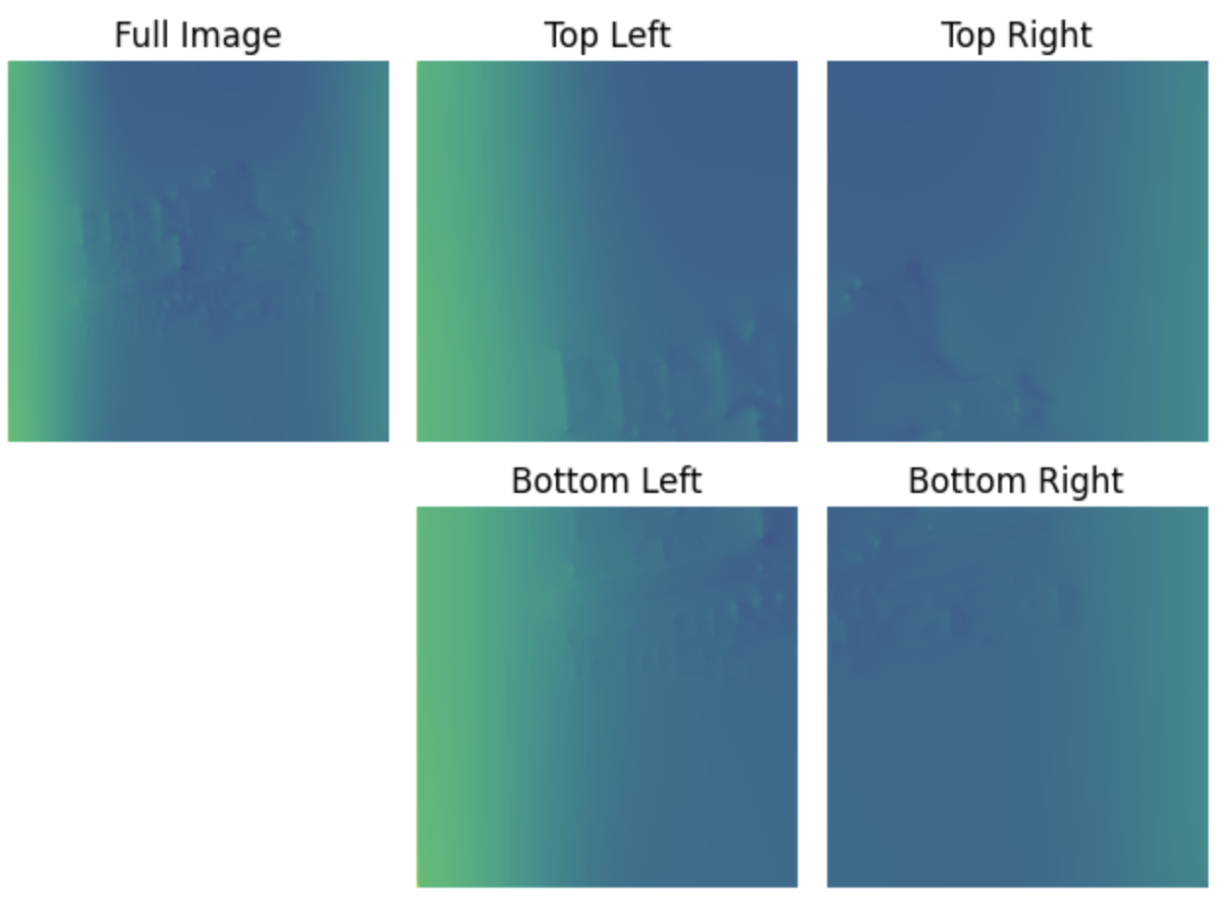
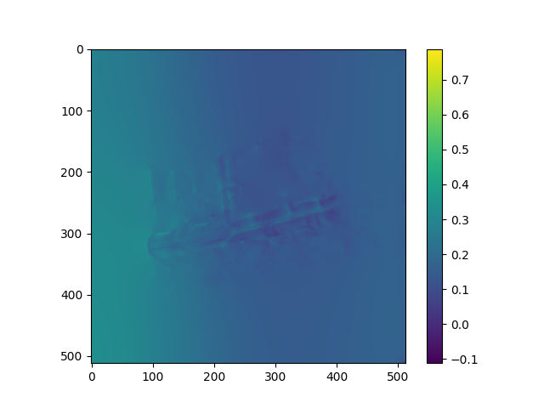
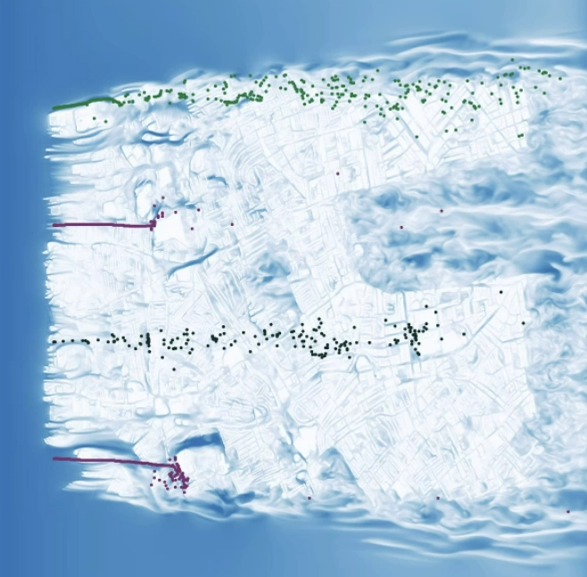
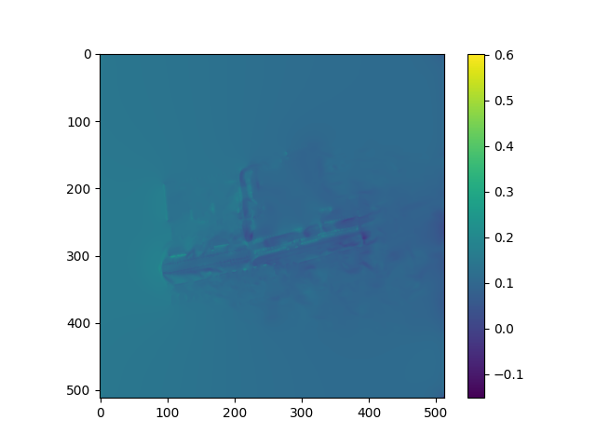
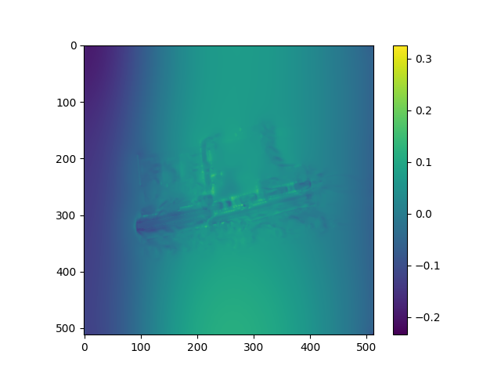
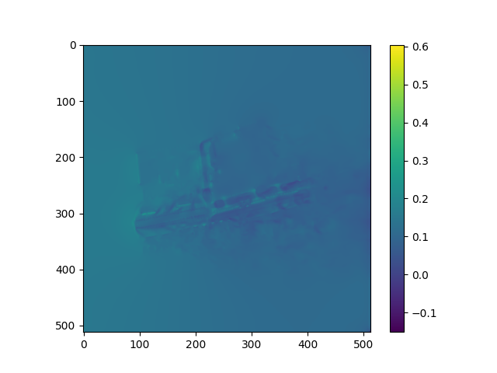

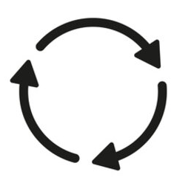
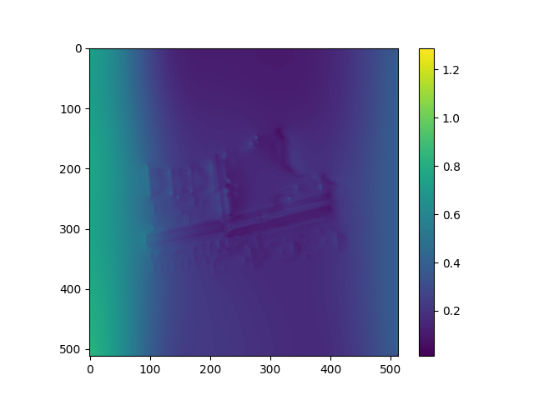
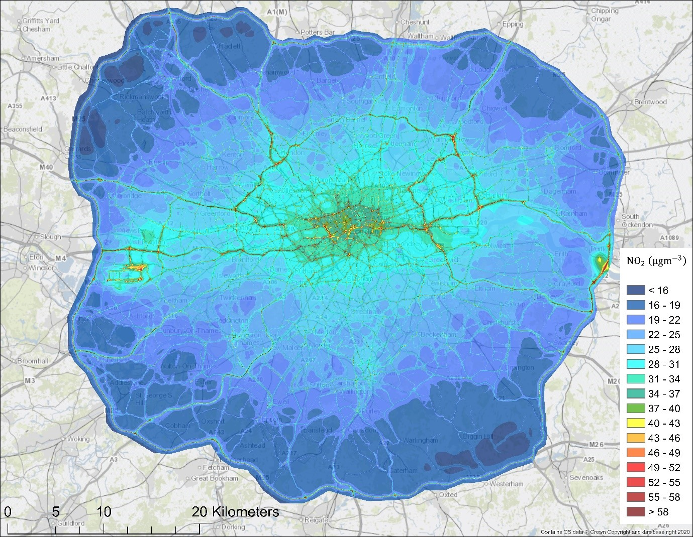
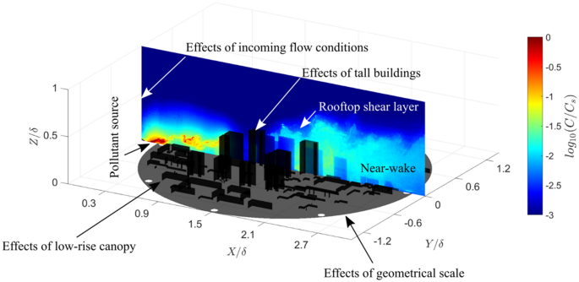
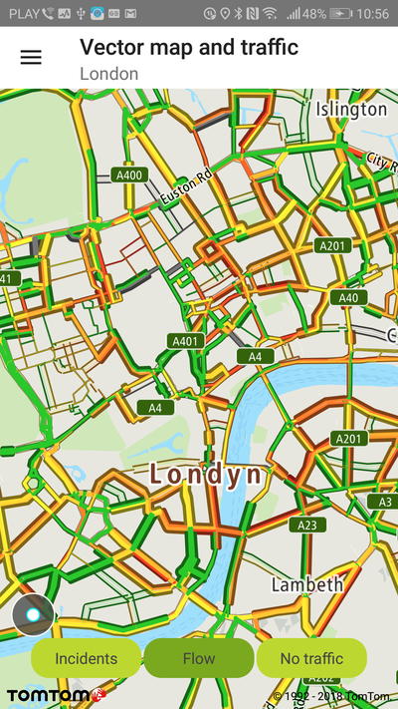
METHODOLOGY – Overview of the Workflow
Convolutional VAE
Conv + Batch Normalization + ReLU
Training Set
(subdomains)
Pooling
Upsampling
Softmax
Generated Initial Condition
Computational Fluid Dynamic
(AI4PDE)
Simulation
Full scaled Initial Condition
(concatenate subdomains)
Historical Data
Encoder
Latent Space
Decoder
Data Mismatch
L_{MSE}(C^{0:T+1}, Ĉ^{0:T+1})
Environmental Data Monitoring
Update
(latent variables)
Observation
𝑥_{0,1}
𝑥_{0,2}
Gradient
Ĉ^{0:T+1} = F(f_{θ}, C^{0:T+1}, T)
Backpropagate Loss (Auto-differentiation)
Structured Mesh
Traffic Data
5
Notes:
Next, we’ll go through how we conducted the research.
Our methodology includes three main components:
To start with, we collected historical data and performed a series of preprocessing for our CVAE.
After training the models, we used them to generate Initial conditions, or initial guesses for further simulation.
Then we incorporated CFD to simulate pollution dispersion in urban area.
Lastly, we applied DA to integrate observational data and continuously refined our models, thus improving the accuracy of the prediction.
And this DA loops would keep going until it reached a target error tolerance

Slide 6
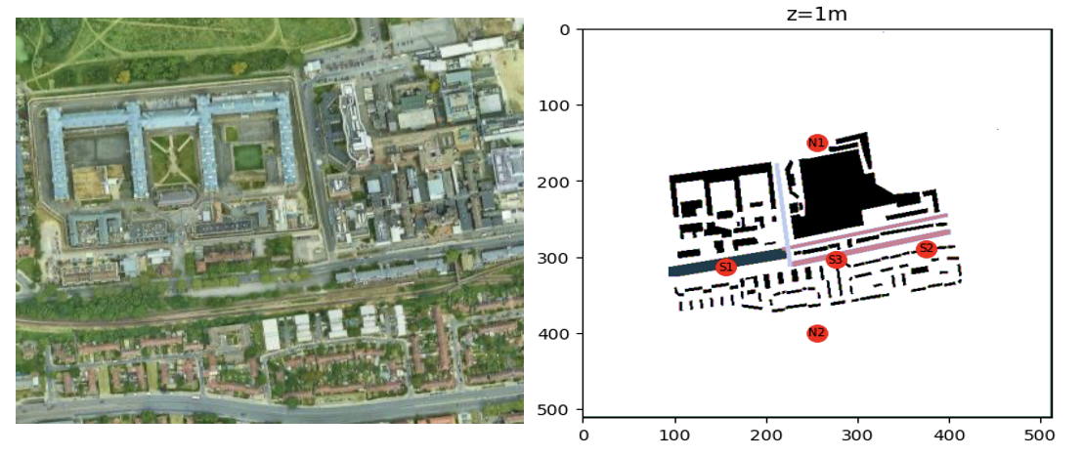
METHODOLOGY - Setup of a Test Case
(512, 512)
Sensor locations: Optimising sensor location using neural networks applied to air pollution (Zhan Xuan & Hong Xuan)
6
Notes:
To validate our framework, we set up a test case located on Du Cane Road in London.
All the data is presented in a structured mesh that captures the detailed layout of buildings, and this mesh has 512x512 equally spaced nodes.
Also, five sensors were placed to record the results, and the locations were decided from the coupling projects conducted also under the guidance of Prof. Pain, Dr. Heaney, and Dr. Chen
After setting up the test case, we'll move on to the data preparation work.

Slide 7
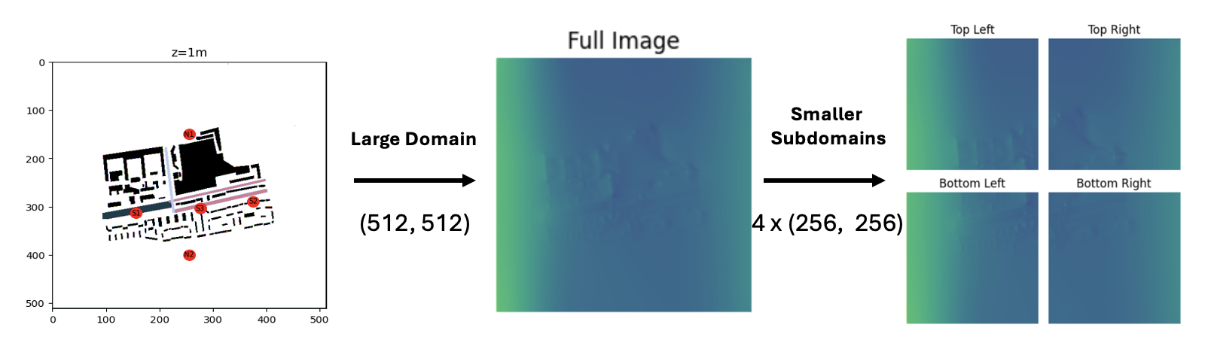
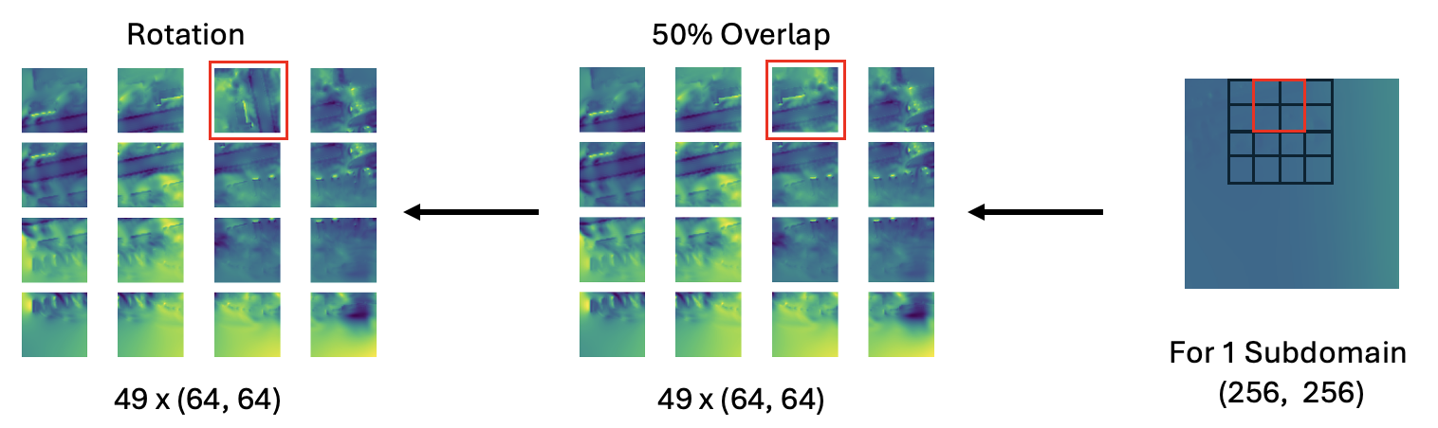
METHODOLOGY – Data Preprocessing
7
Notes:
Data preprocessing is the fundamental step in our workflow.
We started by separating the domain into 4 smaller and more manageable subdomains, based on the computational resources provided.
And all the subdomains are subjected to augmentations to enhance the robustness of the training dataset
This includes further breaking it down into smaller grids that overlap the adjacent ones by 50%, preserving the continuity of information in terms of space, as demonstrated in the bottom right corner of the figure.
So, that means every subdomain is divided into 49 small grids as the training data from one time step, and there are hundreds of time steps collected as historical data in total.
Moreover, some girds are randomly rotated to ensure that the model is exposed to a wider variety of scenarios, this is for the generalisation of the model

Slide 8
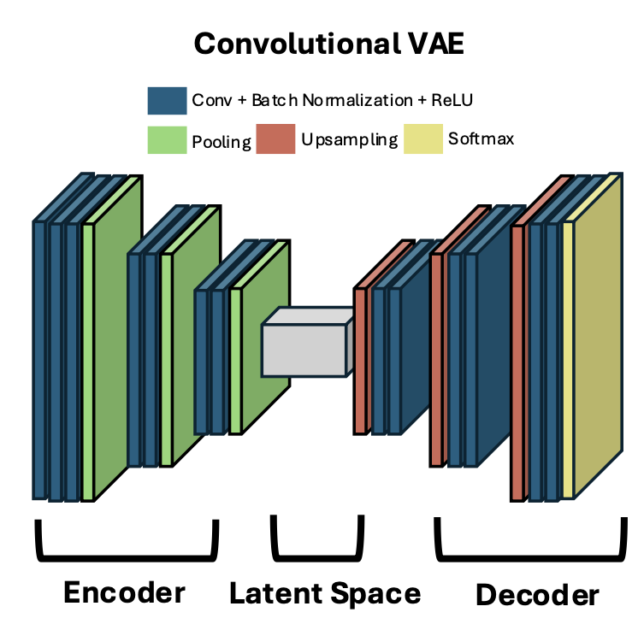
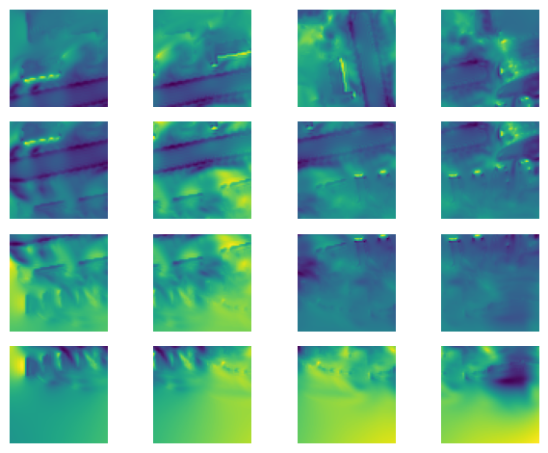
METHODOLOGY – Convolutional VAE
For Each Subdomain
(4 in total)
Priors
(Overlap, Rotation)
1 x (512, 512)
(256, 256)
49 x (64, 64)
3x64x64x64=786,432
64x8x8x8 = 32,768
8
Notes:
After dividing into 4 subdomains and undergoing a series of operations, these processed data are treated as priors and fed into 4 independent models for each subdomain
Our NN model is based on a CVAE, which is designed to reduce the complexity of the data into a smaller latent space
Here in our case, the dimension of the data is compressed from around 800 thousands to 32 thousands, which is a great reduction ratio for the efficiency of the framework

Slide 9
METHODOLOGY – Convolutional VAE
Convolutional VAE
(4 Independent Models)
Generated Initial Guess
(For Each Subdomain)
Generated Initial Guess
(Full Domain)
Computational Fluid Dynamic
(AI4PDE)
Simulation
Latent Space
Decoder
49 x (64, 64)
(256, 256)
4 x (256, 256)
1 x (512, 512)
9
Notes:
After having 4 trained models, the decoders generate realistic initial conditions, and that is 49 small grids for each subdomain.
Then, we take the average of the overlapping areas to smooth them and put them back together into the size of one subdomain, which is (256x256)
And next, we concatenate all 4 subdomains back together into its original size of the mesh (512x512) before running the CFD simulation
The reason that we break it down is because it’s more efficient and more manageable instead of doing all the process on a whole

Slide 10
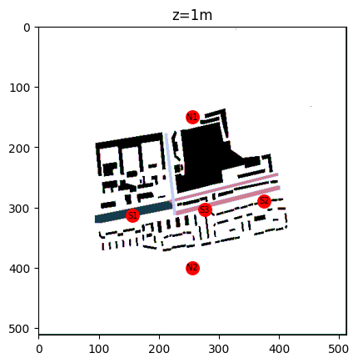
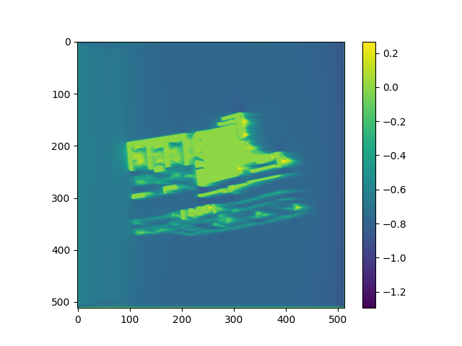
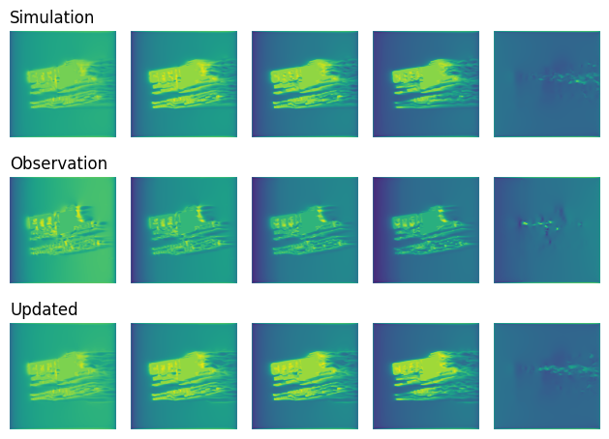
METHODOLOGY – CFD Simulation
Generated Initial Condition
Computational Fluid Dynamic Model
(10000 timesteps)
Simulation Result
10
Notes:
The simulation uses 10,000 timesteps to compute how pollution spreads under the influence of wind speed across the area.
And the result of the simulation is served as a baseline for comparison against observational data

Slide 11
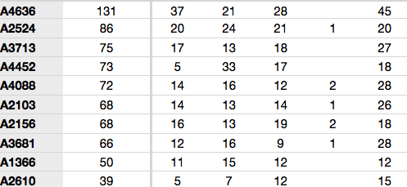
METHODOLOGY – Observational Data
Raw Data
(cleansing, missing values)
Computational Fluid Dynamic Model
(1 timesteps to create structured mesh)
Observational Data
11
Notes:
And these observational data were sourced from a company, Open Weather.
After processing the raw data, we extracted the region we targeted to create a structured mesh for the next step, DA

Slide 12
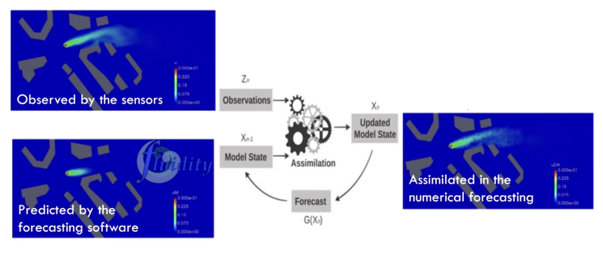
METHODOLOGY – Data Assimilation
12
Notes:
DA is the final step of our methodology, where we continually update our model with observational data, as this figure illustrates.

Slide 13
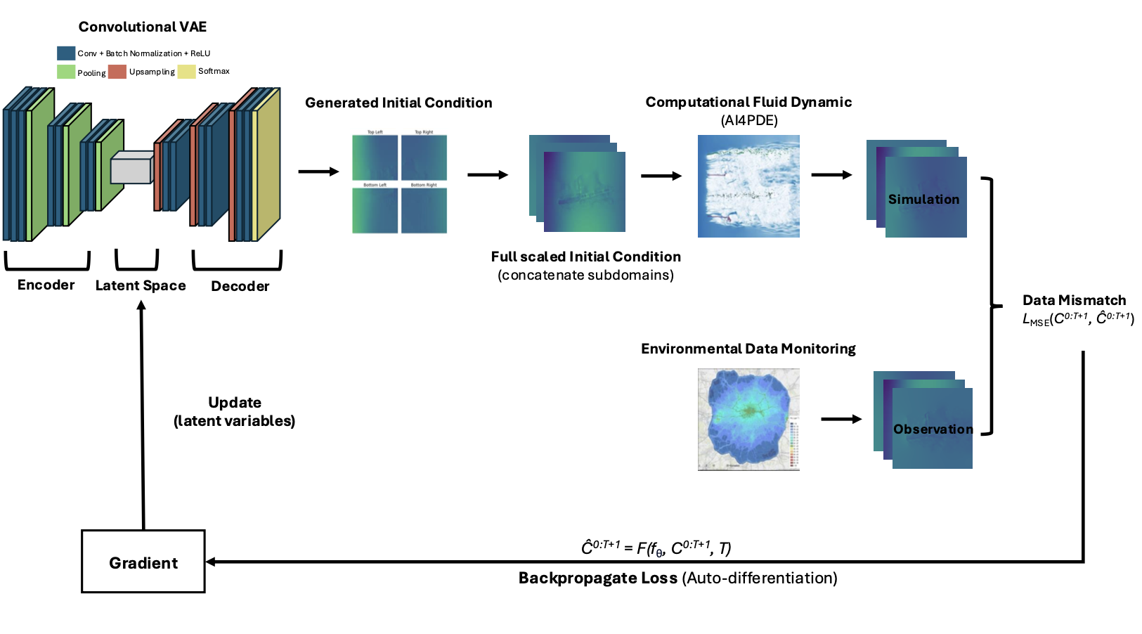
METHODOLOGY – Data Assimilation Loop
13
Notes:
And for our framework, here is a detailed view of our DA loop
It first includes the generation of initial condition from AE, then it's the simulation of results, and finally the comparison with observational data.
After calculating the data mismatch and gradient from backpropagation process,
the model, specifically the latent variables are updated for the next loop until convergence

Slide 14
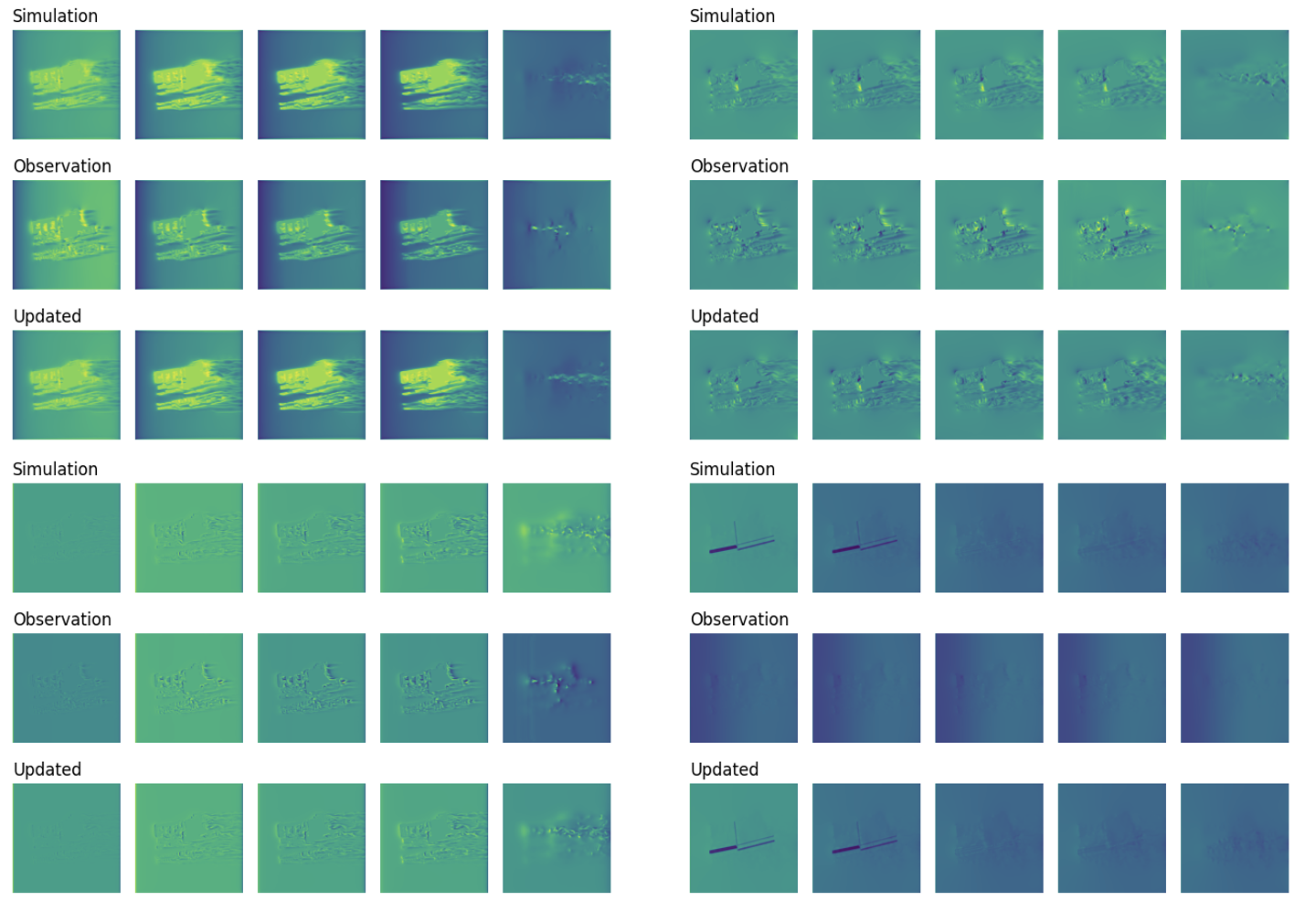
RESULTS - Velocity and Pollution Field
Wind Velocity in X-Direction
Pollution Concentration Field
14
Notes:
The results of our study show significant improvements in wind velocity and the pollution concentration field.
As you can see in these figures, the updated predictions closely match the observational data collected, which are presented respectively in the second and third rows.
And this validates the effectiveness of our approach.

Slide 15
RESULTS - Velocity and Pollution Field
Wind Velocity in Z-Direction
Wind Velocity in Y-Direction
15
Notes:
Here, we also present the wind velocity in Y and Z directions.
Again, we can see the resemblance between updated prediction and observational data

Slide 16
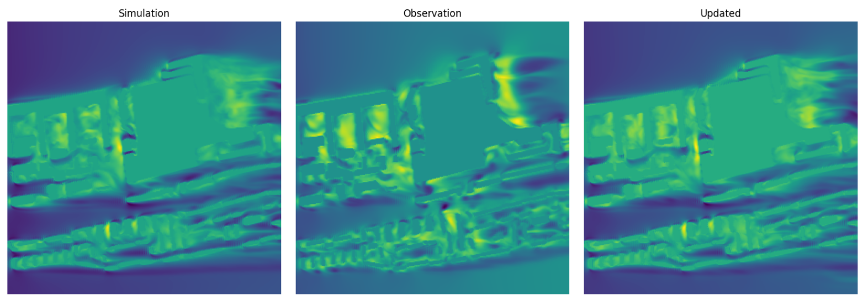
RESULTS - Detailed Analysis
(Velocity Field in x-direction at 1-Meter Height)
16
Notes:
To look into the details, here is the analysis of velocity field in x-direction at 1-meter height.
The accuracy of our model at this height is most important because the result at ground level has most direct impact on human health.
In this figure, you can see the the refinements, and they’re especially obvious in the highlighted areas.

Slide 17
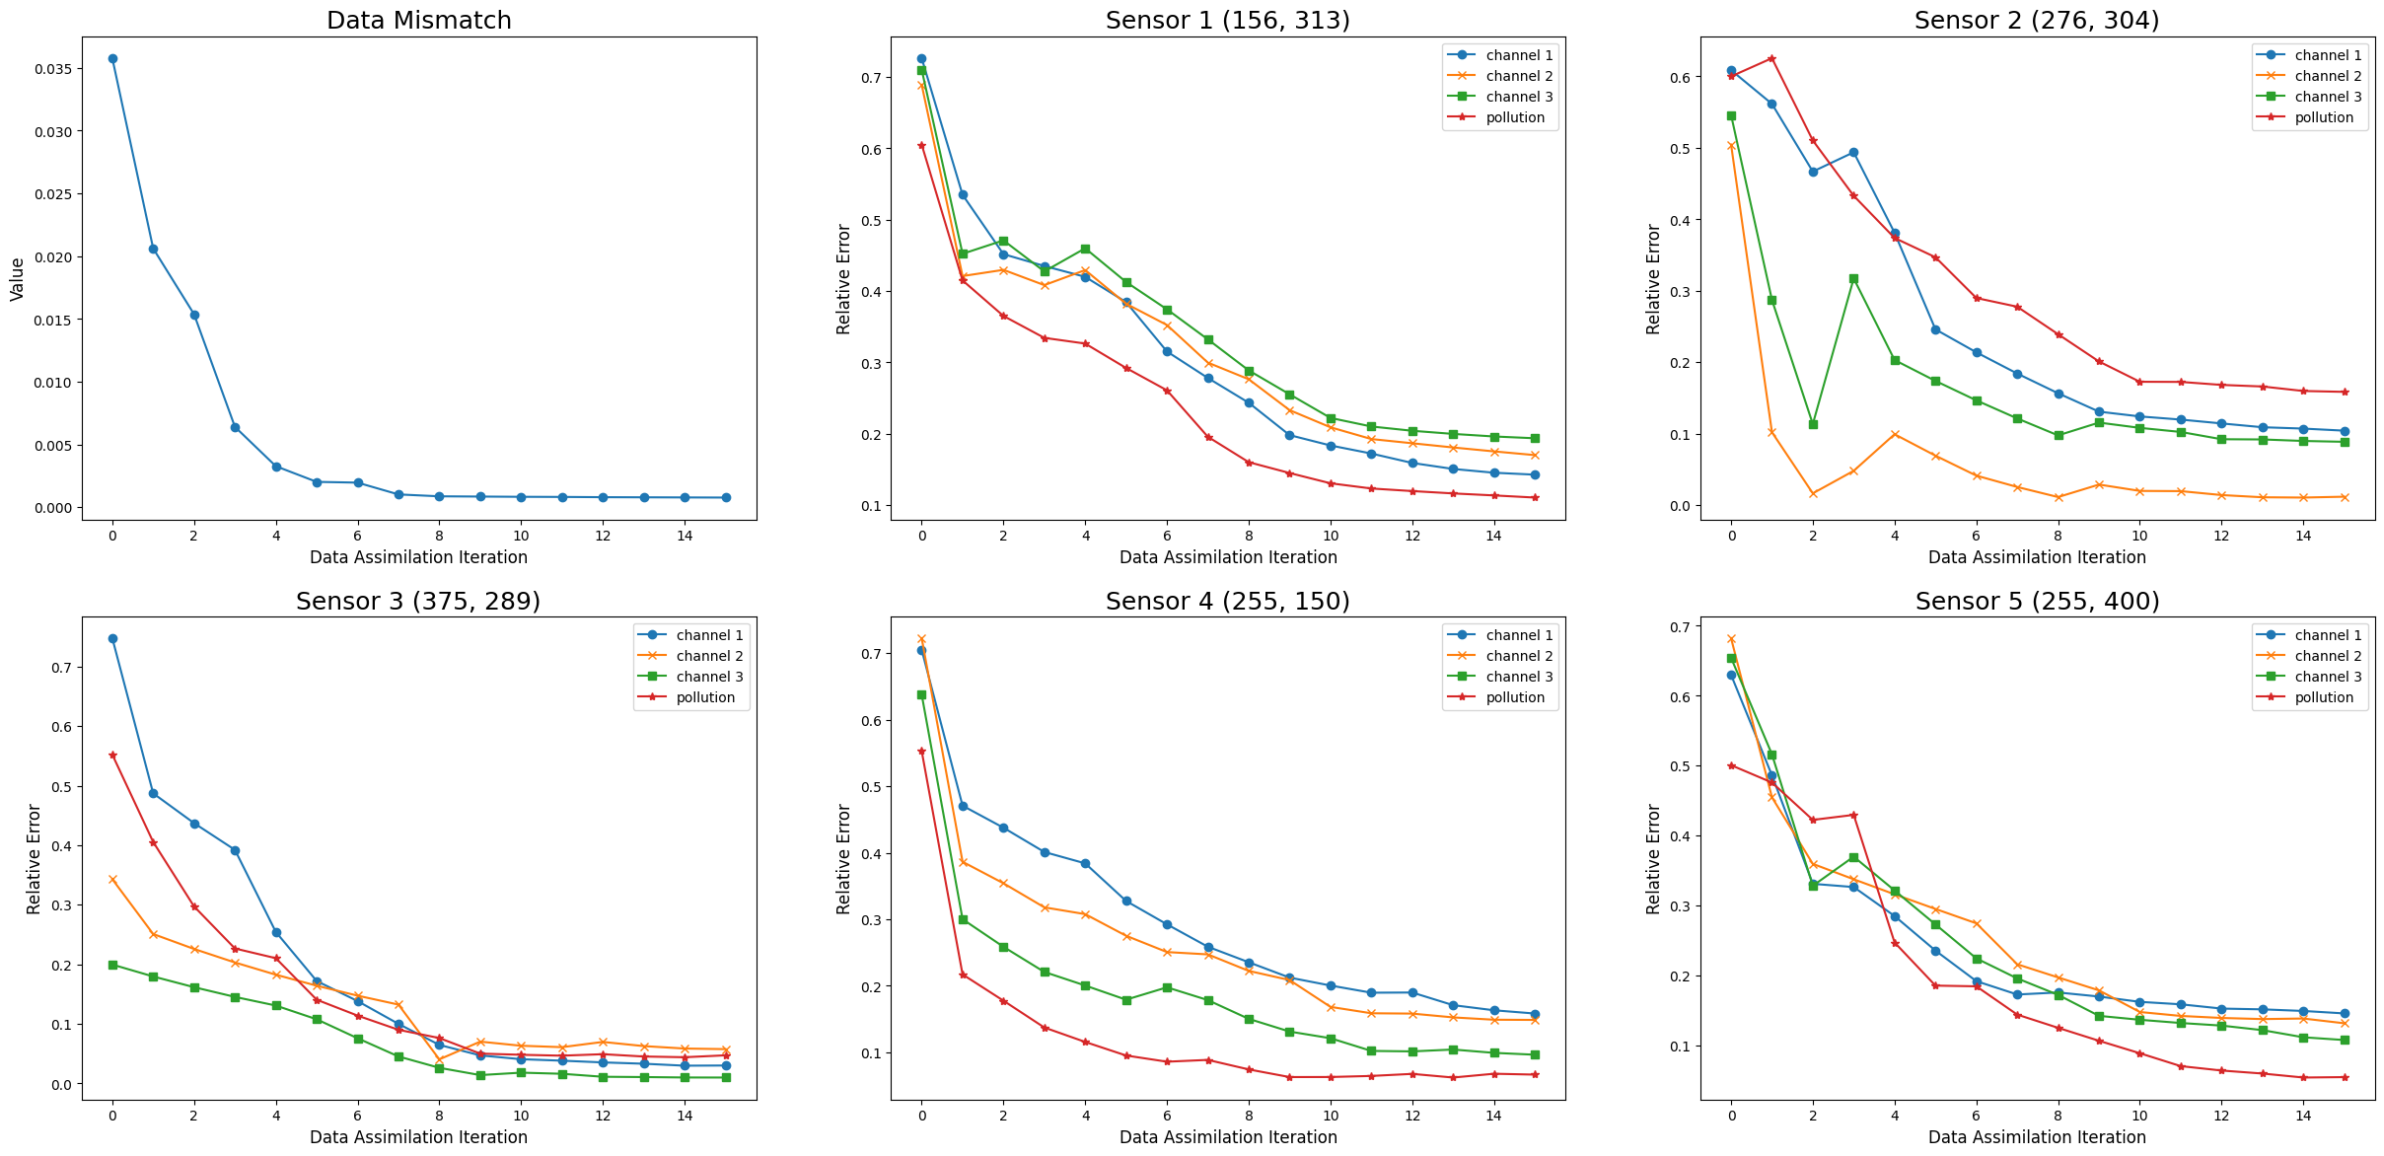
RESULTS – Data Mismatch & Sensor Performance
17
Notes:
Here, we also visualize and quantify the data mismatch and relative error in sensor locations with respect to the number of iterations of DA.
In the top left corner, the data mismatch dropped from .035 to less than .0001 and we can observe the convergence, while overall sensor performance remained below 10%,
which again validated our approach to a certain level of error tolerance

Slide 18
CONCLUSION & DISCUSSION
1
2
3
Novel Framework
- Neural Networks
- Computational Fluid Dynamic
- Data Assimilation
Large-Scale Predictions
Feasibility for a smaller domain
Relative Error < 10%
Environmental Policy
Moving Window Strategy
Memory Issue
Stored and Reloaded
In terms of Time
18
Notes:
To conclude,
1.
In this study, we presented a novel and comprehensive framework that integrated NN, CFD, DA
to effectively and accurately improve the prediction of air pollution.
2.
This approach is also scalable to larger domains, such as entire cities or countries.
In this research, it’s been highlighted that the observational data was well-assimilated, in our test case
Therefore, by scaling up the model, it could offer insights into pollution dispersion patterns for urban planning or policies regarding to the environment and public health
3.
Finally, with the help of AE, the amount of computational resource required has been greatly reduced already.
However, a significant challenge encountered during the implementation was still the intensive amount of memory needed.
This issue was most pronounced during the back propagation step, as it kept track of all the values computed during forward simulation, which involved thousands of time steps and millions of values.
Therefore, we employed a strategy call “moving window”. This is performed in terms of time, and as how it’s named, the current result and the updated model were stored after numbers of iterations, and reloaded for subsequent loops,
This really helped eliminating the memory issue confronted when dealing with large dataset.
We observed that this strategy is not exclusive to this study, but it can also be applied to others. It’s a general way to avoid memeory issue, especially when the amount of resources is limited

Slide 19
Modelling pollution in the urban environment using neural networks
Hanson Shen
Prof Christopher C. Pain
Dr Claire E. Heaney
Dr Boyang Chen
19
Notes:
Thank you for your attention. I’d be happy to take any questions you may have!

